Slide 1
Decision Tree
By: S Rengashree
Aspiring data analyst

Slide 2
What is Decision Tree?
It is a graphical representation for getting all the possible solutions to a problem/decision based on given conditions.
It is called a decision tree because, similar to a tree, it starts with the root node, which expands on further branches and constructs a tree-like structure.
A decision tree simply asks a question, and based on the answer (Yes/No), it further split the tree into subtrees.

Slide 3
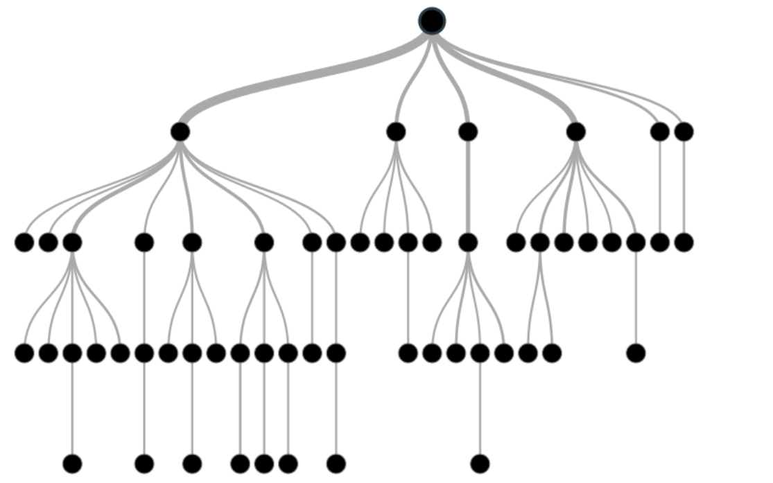
How a Decision Tree algorithm looks

Slide 4
Key Features of a Decision Tree model
Supervised machine learning algorithm
Predictive model
Non – Parametric model
Used for both Classification (DecisionTreeClassifier) and Regression (DecisionTreeRegresser) problems
Iterative process
Greedy algorithm
Top to Bottom approach

Slide 5
Representation, Evaluation and Optimization of a Decision Tree model
Representation: Tree based representation
Evaluation: Probabilistic metrics
Optimization: Split using Entropy/Gini Index and Information Gain
Method: Iterative Dichotomiser 3(ID3), Classification and Regression Tree(CART), Chi-Square Automatic Interaction Detection(CHAID)

Slide 6
Nodes in Decision Tree
Root Nodes – It is the node present at the beginning of a decision tree from this node the population starts dividing according to various features.
Decision Nodes – the nodes we get after splitting the root nodes are called Decision Node
Leaf Nodes – the nodes where further splitting is not possible are called leaf nodes or terminal nodes
Sub-tree – just like a small portion of a graph is called sub-graph similarly a sub-section of this decision tree is called sub-tree.
Pruning – is nothing but cutting down some nodes to stop overfitting.
Parent/Child node – The root node of the tree is called the parent node, and other nodes are called the child nodes.

Slide 7
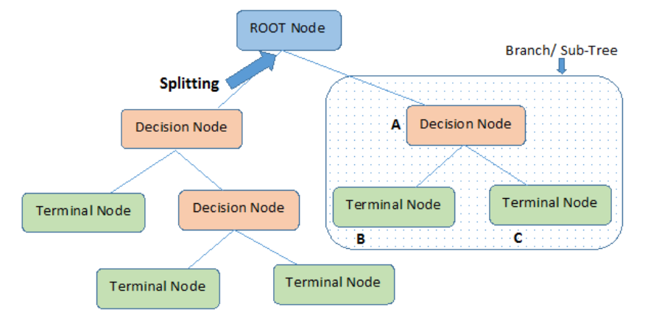

Slide 8
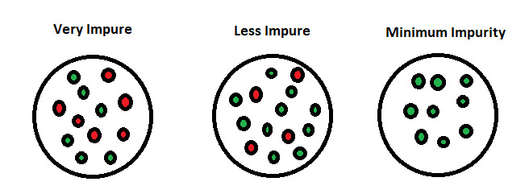
What is Entropy?
Entropy is a measure of disorder or uncertainty or purity and the goal of machine learning models is to reduce uncertainty.

Slide 9
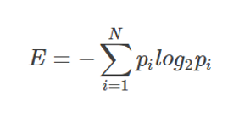
Formula for Entropy
Consider a dataset with N classes. The entropy may be calculated using the formula below, Where p_{i} is the probability of randomly selecting an example in Class i:

Slide 10
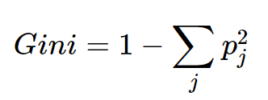
What is Gini Index?
Gini Index, also known as Gini impurity, is a measure of impurity or purity used while creating a decision tree in the CART(Classification and Regression Tree) algorithm.
An attribute with the low Gini index should be preferred as compared to the high Gini index.

Slide 11
Difference between Entropy and Gini Index
The Gini Index and the Entropy have two main differences:
Gini Index has values inside the interval [0, 0.5] whereas the interval of the Entropy is [0, 1].
Computationally, entropy is more complex since it makes use of logarithms and consequently, the calculation of the Gini Index will be faster.
The classic CART algorithm uses the Gini Index for constructing the decision tree.

Slide 12
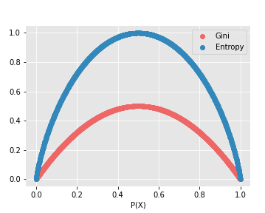

Slide 13
What is Information Gain?
We can define information gain as a measure of how much information a feature provides about a class. Information gain helps to determine the order of attributes in the nodes of a decision tree.
Information Gain = Entropy before splitting - Entropy after splitting
Information gain determines the reduction of the uncertainty after splitting the dataset on a particular feature such that if the value of information gain increases, that feature is most useful for classification.
The feature having the highest value of information gain is accounted for as the best feature to be chosen for split.

Slide 14
Let us now look into the steps involved in decision tree

Slide 15
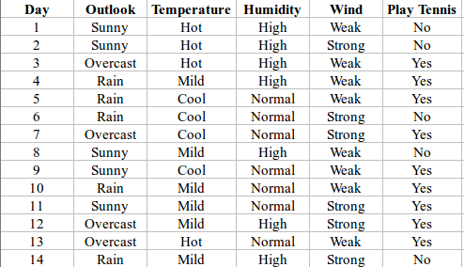
Let us consider the following dataset

Slide 16
Steps Involved in Calculating the Entropy and Information Gain for Split:
Step 1: Calculating the total entropy of the dependent feature
Step 2: Calculating the Entropy of all the categories in each feature with respect to dependent variable
Step 3: Calculating the Entropy of each feature
Step 4: Calculating the information Gain using entropy from Step 3
Step 5: Choosing the feature with the highest value of information gain for the split

Slide 17
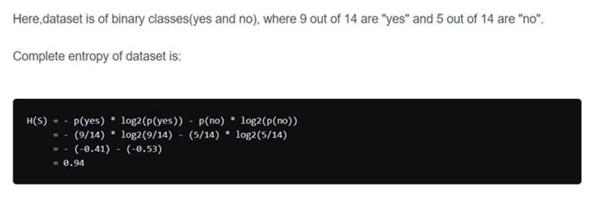
Step 1: Calculating total Entropy of the dependent feature

Slide 18
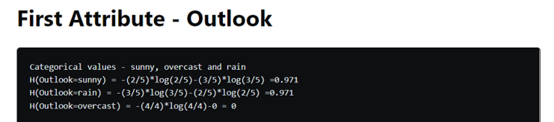
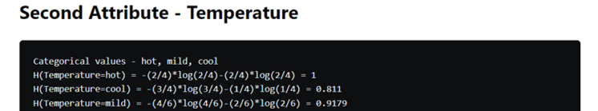
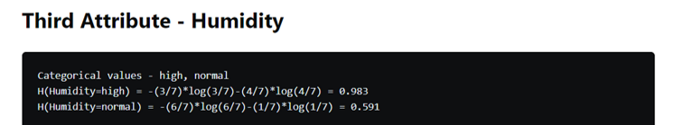
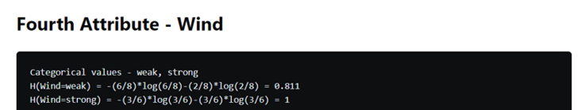
Step 2: Calculating Entropy of all the categories within each feature

Slide 19
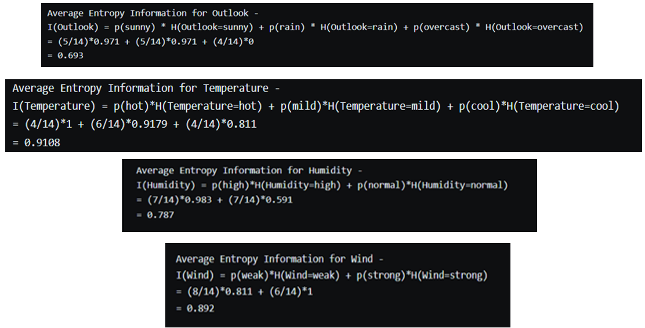
Step 3: Calculating Entropy of each feature

Slide 20
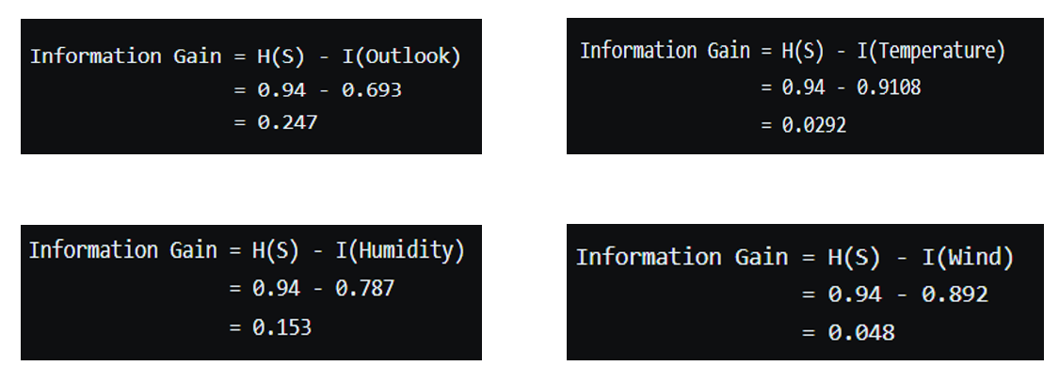
Step-4: Calculating the Information Gain of each feature

Slide 21
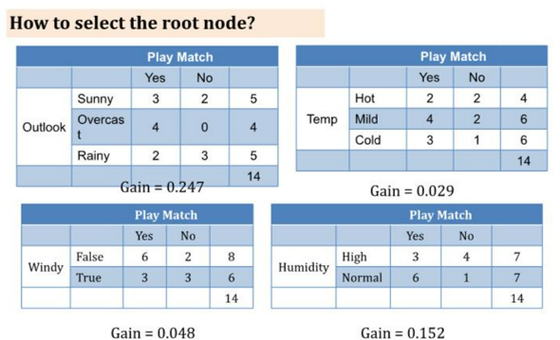

Slide 22
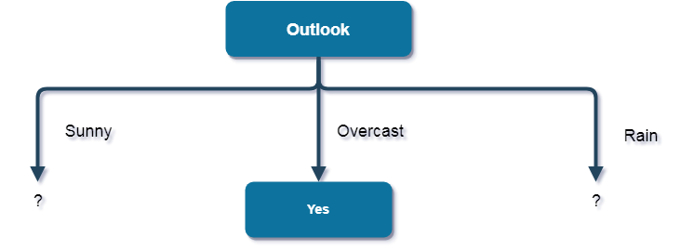
Step 5: Using the feature with highest information gain to make the split
Here, the attribute with maximum information gain is Outlook. So, the decision tree built so far:
Here, when Outlook == overcast, it is of pure class(Yes). Now, we have to repeat same procedure for the data with rows consist of Outlook value as Sunny and then for Outlook value as Rain.

Slide 23
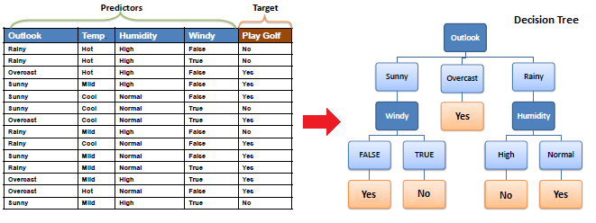

Slide 24
Why does the decision tree algorithm has low bias and high variance?
Bias error
Bias error is due to our assumptions about target function. The more assumptions(restrictions) we make about target functions, the more bias we introduce. Models with high bias are less flexible because we have imposed more rules on the target functions.
Variance error
Variance error is variability of a target function's form with respect to different training sets. Models with small variance error will not change much if you replace couple of samples in training set. Models with high variance might be affected even with small changes in training set.
The tree makes almost no assumptions about target function but it is highly susceptible to variance in data.
There are ensemble algorithms, such as random forest, which aim to reduce variance at the small cost of bias in decision tree.

Slide 25
Advantages of using a Decision Tree model
Clear Visualization
Simple and easy to understand
No feature scaling required
Handles non-linear parameters efficiently
Decision Tree can automatically handle missing values.
Decision Tree is usually robust to outliers and can handle them automatically.
Less Training Period

Slide 26
Disadvantages of using a Decision Tree model
Overfitting
High variance
Unstable
Not suitable for large datasets

Slide 27
Thank you ☺

